Slide 1
SALES PERFORMANCE DASHBOARD ON TABLEAU
Presented by
Debapriya Das
Date-07.08.2025

Slide 2
INTRODUCTION AND OBJECTIVE
Sales performance dashboard is a very important tool in modern day to undertake crucial decisions by managers and policy makers.
This provide important data and overview to identify trends using various KPIs and time series analysis.

Slide 3
DATA OVERVIEW
Source of data- Financial sales data from Kaggle
Data Period- 2023-2025
KPIs included- Sales, Profit, Growth rate

Slide 4
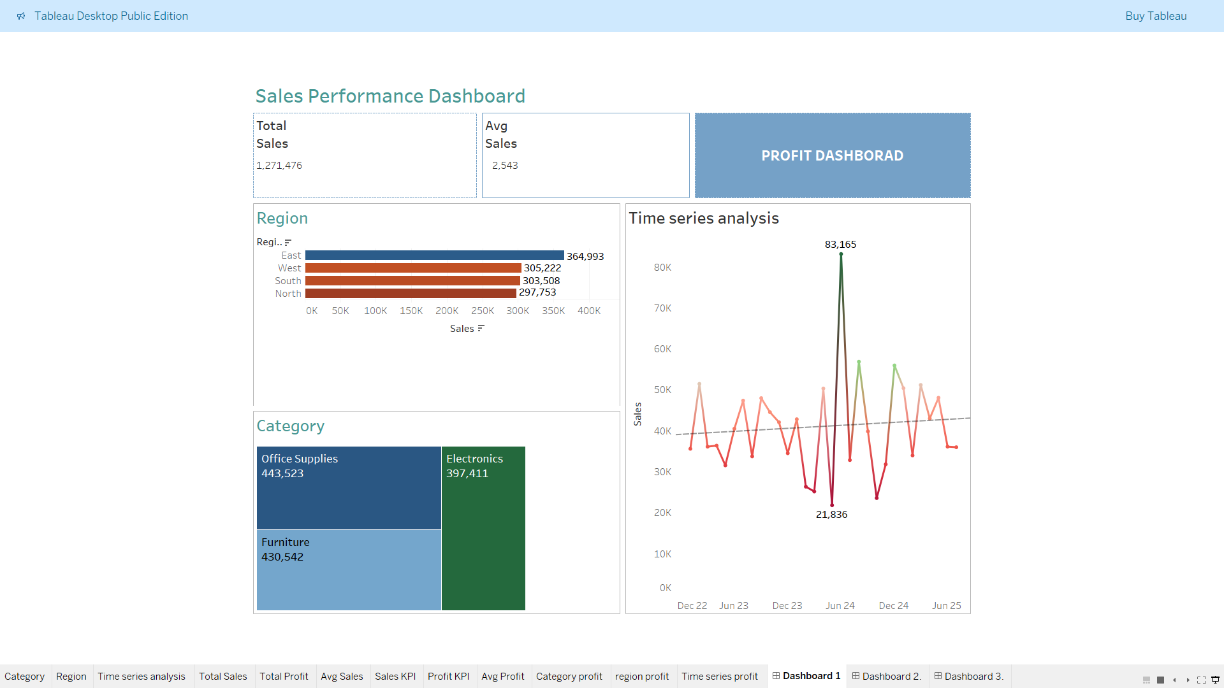
DASHBOARD DESIGN IN TABLEAU
Sales dashboard

Slide 5
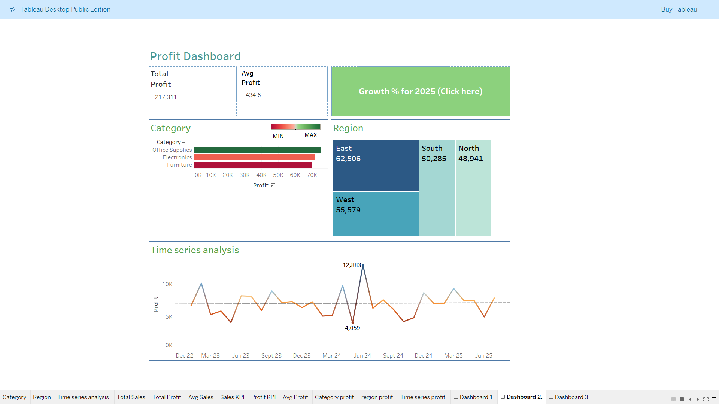
PROFIT DASHBOARD

Slide 6
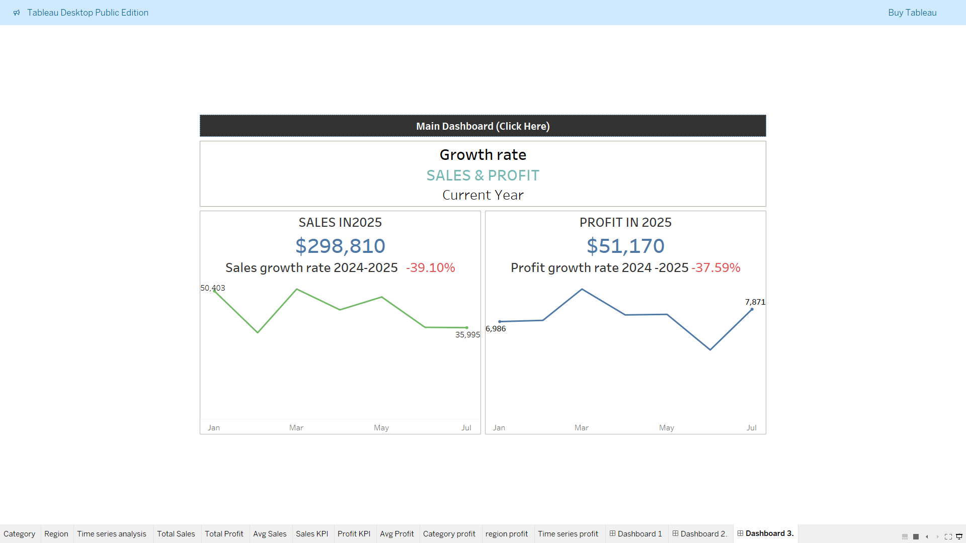
GROWTH RATE DASHBOARD

Slide 7
CONCLUTION
Summary of findings
Sales performance have been indicated region wise, category wise. Along with that time series analysis have also been provided.
Similarly, the profit have been represented and cards have been displayed at top representing total and average values for both sales and profit.
Along with this growth rate of current year have been represented for both sales and profit.

